Slide 1

Crime Against Women
Here is where your presentation begins

Slide 2

Introduction
blood
Crimes against women include offenses that specifically target women due to their gender.
Understanding these crimes is essential for ensuring justice and promoting gender equality.

Slide 3
Types of Crimes Against Women
1. Sexual Violence:
Rape, molestation, and harassment.
2. Domestic Violence:
Physical, emotional, and psychological abuse within households.
3. Dowry-Related Crimes:
Harassment, death, and extortion linked to dowry demands.

Slide 4
Sexual Violence
1. Rape:
Defined as forced or non-consensual sexual activity.
2. Harassment:
Includes workplace harassment and stalking.
Example: Statistics on reported cases of rape globally or locally.

Slide 5
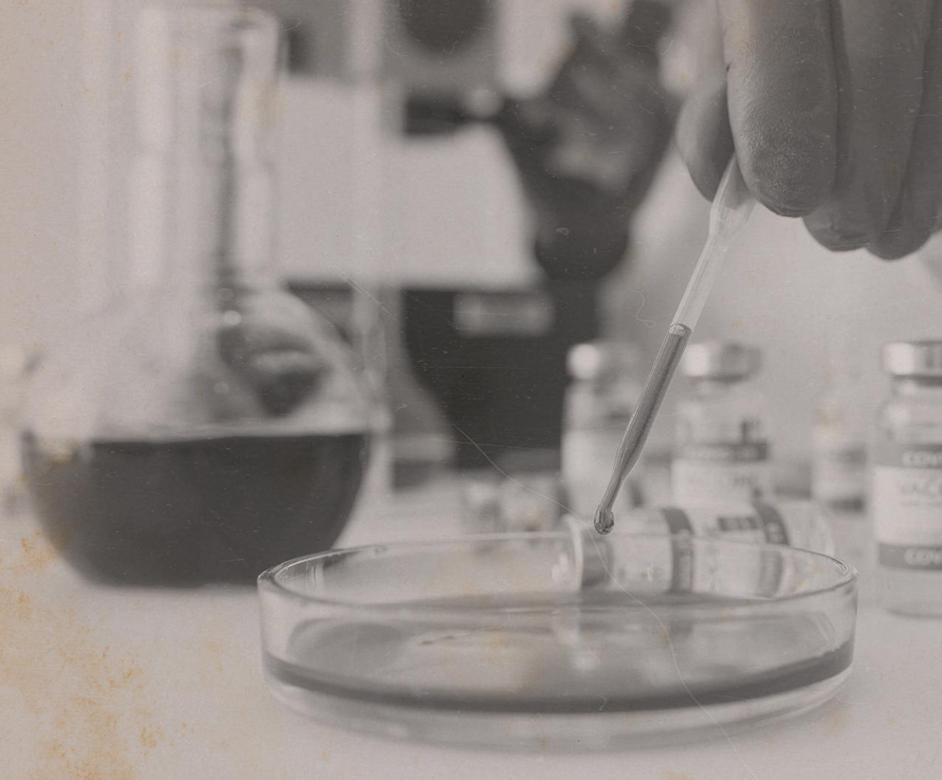
01011
Domestic Violence
1. Physical Abuse:
Assault and battery within the family.
2. Emotional Abuse:
Verbal insults, isolation, and intimidation.
Laws in place:
Domestic Violence Act 2005 (India) as an example.
CRIME

Slide 6

Dowry-Related Crimes
1. Dowry Harassment:
Mental and physical torture for dowry demands.
2. Dowry Deaths:
Deaths caused by disputes over dowry are often disguised as accidents.
Legal Reference: Section 498A and 304B of IPC (India).
HOMICIDE

Slide 7
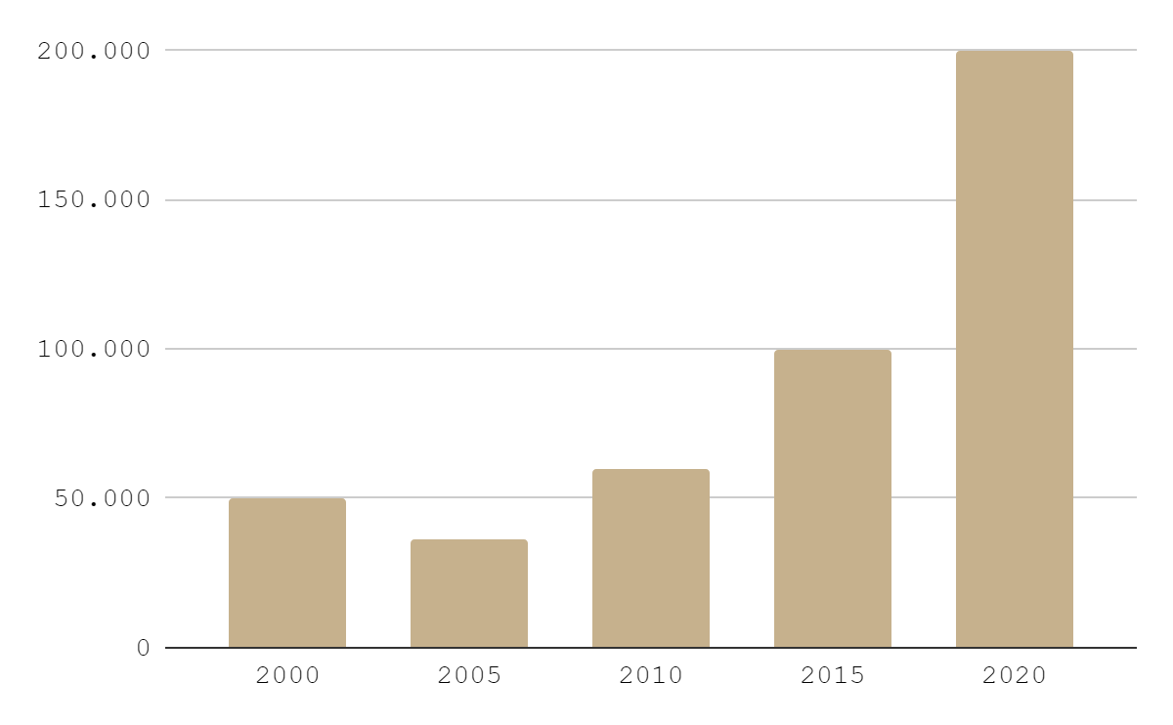
Tamil Nadu Women safty RATE
200,000
Women Safety
50,000
Case are find out and close the record

Slide 8

Legal Framework for Rape Cases
1. Definition of Rape:
Forced, coerced, or non-consensual sexual activity.
2. Laws Addressing Rape:
Protection of Women under laws like IPC Section 376 (India) or equivalent globally.

Slide 9
Preventive Measures
1. Awareness Campaigns:
Educating the public about women's rights.
2. Strengthening Laws:
Harsher punishments for offenders.
3. Community Support:
Empowering women through education and economic independence.

Slide 10
Role of Society
1. Challenging Gender Norms:
Addressing patriarchal attitudes and stereotypes.
2. Encouraging Reporting:
Creating safe spaces for victims to report crimes.
3. Supporting Victims:
Rehabilitation programs and counseling.

Slide 11
Conclusion
Crimes against women are a significant societal issue requiring comprehensive solutions.
Through legal reforms, societal support, and empowerment, we can ensure justice and safety for women.

